Slide 1
Azure
DURABLE
FunctionS
Janusz Jasiński

Slide 2
ServerLeSS
Serverless is a cloud-native development model that allows developers to build and run applications without having to manage servers. There are still servers in serverless, but they are abstracted away from app development.
Notes:
Azure functions are part of Microsoft Serveless offering,
easier deployment and
pay for what you use only

Slide 3
Azure FunctionS
PROS
CONS
Simple programing model
Different languages supported: .net, python, javascript,
Support for lots of triggers
Different price models:
  Consumption plan
  Premium plan
  Dedicated plan
Cold start
Short default execution time (but can be extended)
Some limits on number of functions in one function app
vendor lock (somewhat)
AZURE PRICING for consumption plan
Meter | Free Grant (Per Month) | Pay as you go
Execution Time* | 400,000 GB-s | €0.000017/GB-s
Total Executions* | 1 million executions | €0.201 per million executions

Slide 4
DEMO
Create Azure Function
Deploy to Azure

Slide 5
DURABLE FUNCTIONS
STATEFUL APPLICATIONS
Support for stateful applications using Durable Functions extension.
COST SAVINGS
Not running while waiting for long running tasks to finish
EASY TO ORCHESTRATE
Lots of scenarios for orchestrations

Slide 6
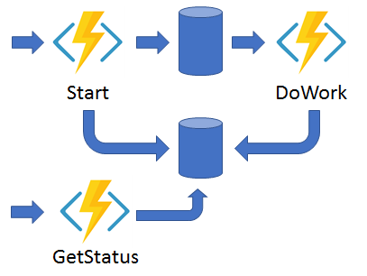
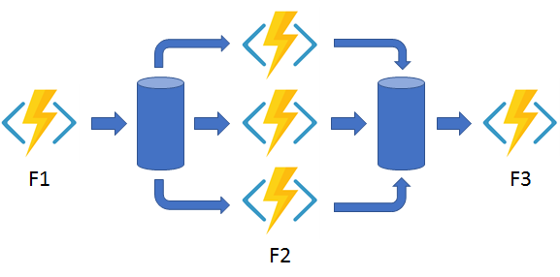
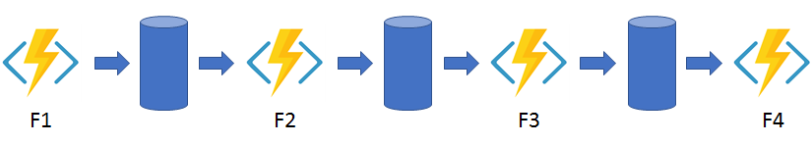
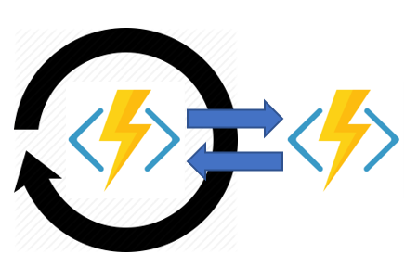
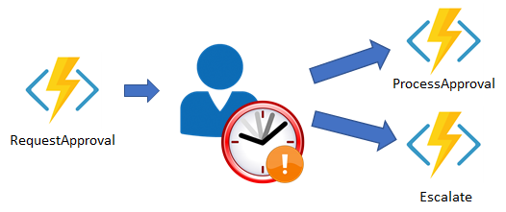
PATTERNS
Function chaining
Fan out/fan in
Async HTTP APIs
Monitor
Human interaction

Slide 7
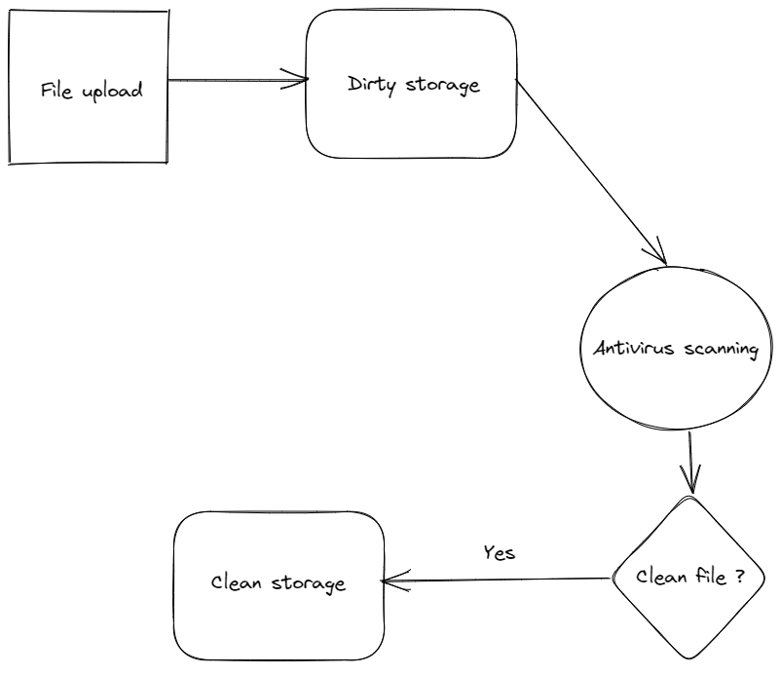
DEMO
https://github.com/januszj/DurableOrchestrator

Slide 8
Q&A

Slide 9
THANK YOU

